Slide 1
SLR AGM –Saturday 25th October 2014
Chairman’s report from
Neville Brewis

Slide 2
Contents
Our Year in Pictures-events/walks/activities
Committee- who’s in and who’s out?
Membership Update
Xmas Meal Update
Next Year’s Outings and Events

Slide 3
Walks Summary
(ex Margaret Ruse)
Margaret Ruse has now assumed the role of Walks Co-ordinator
Walks programmes (2 off) both successfully completed on time and in full through out the year.
Numbers on walks ranged from 4(in extreme heat in July ) to 17 (in less extreme conditions)
Average on both Sundays and Thursdays seems to be 12 to 14 walkers
Good to see new walks leaders coming forward (ex David Hayes Graduate school !)
More later under item 6

Slide 4
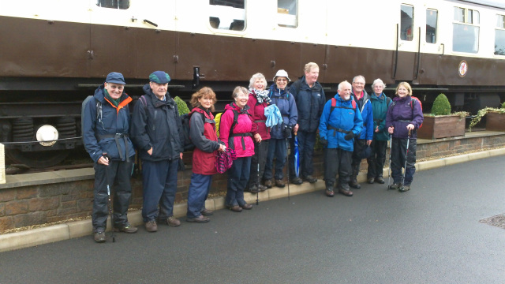
NOVEMBER-David Hayes’s walk on Strawberry Line at Sandford

Slide 5
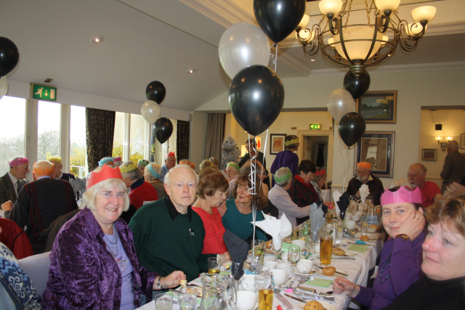
December –XMAS MEAL AND WALKS

Slide 6
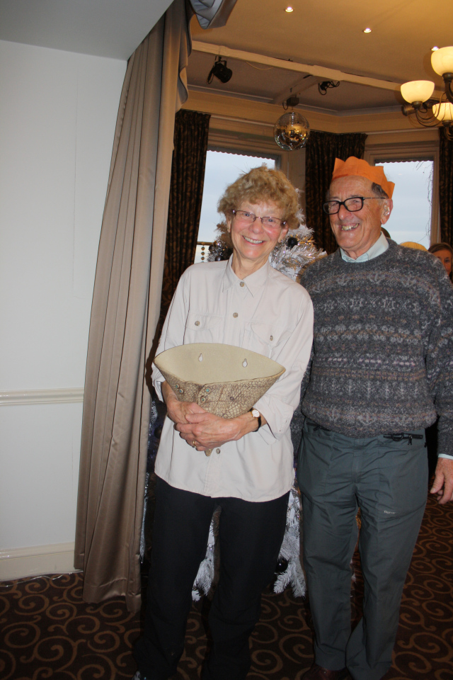
DECEMBER –XMAS MEAL /WALKS
Don and Pat’s Presentations

Slide 7
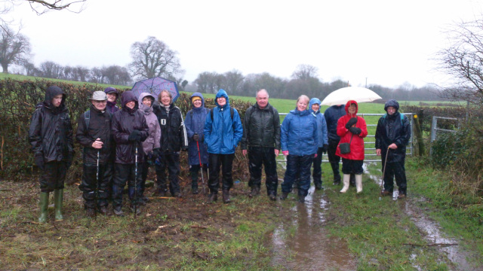
New Year’s Day Walk !!

Slide 8
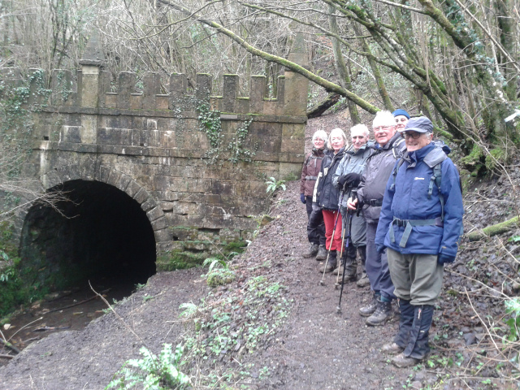
FEBRUARY – Dick’s walk along Thames and Severn Canal/Sapperton Tunnel

Slide 9
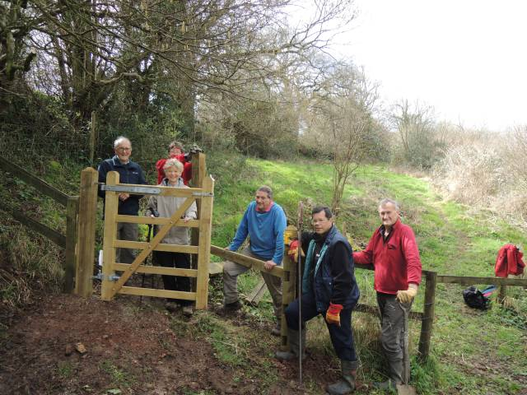
MARCH-KISSING GATE INSTALLATION

Slide 10
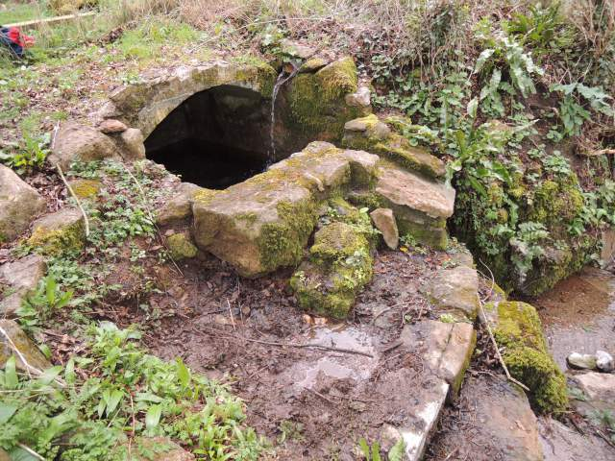
March –Rag Well at Compton Martin

Slide 11
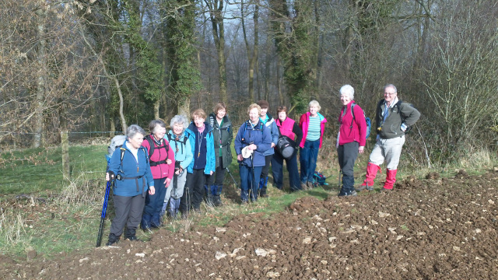
March –Sue Bartlett’s walk at Kingscote and Horsley

Slide 12
March – Spring Social at St. Mary's Church Hall
Our speaker was Mandy Leivers, Avon Gorge and Downs Biodiversity Education Officer who gave a very interesting talk on the fauna/flora/wildlife to be found there.
Mandy’s talk highlighted the many Avon Gorge and Downs Wildlife /Conservation Projects being undertaken –for more details see their Website at
www.avongorge.org.uk/
The talk was followed by an American buffet supper and refreshments.

Slide 13
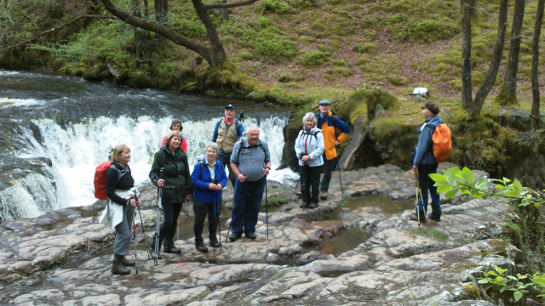
April – David McG’s Waterfall walk from Pont Nedd Fechan

Slide 14
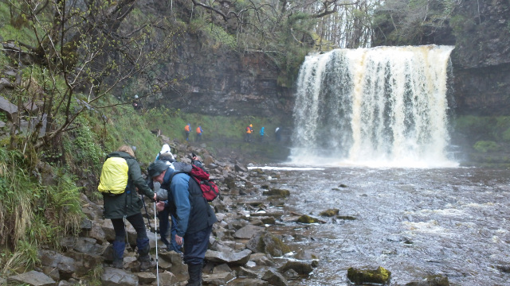
April - Waterfall Walk

Slide 15
Q 4/13-Q1/14 Walks Leader’s Training
David Hayes led a class of 11 willing pupils
9 X 90 minute meetings held at David’s house at fortnightly intervals.
Topics covered:-Selecting your walk, Downloading and Highlighting your walk, Finding location( GPS/OS maps/Compass), First Aid, Group Dynamics, SMART Phone Technology and “How to avoid getting lost !”.
Positive Outcomes:-
*New walks Leaders (Liz, Sue and Helen)
*First Aid Training organised and new kits to be bought.
*OS Maps Library now in place.
Many thanks go to David for the success of this venture.

Slide 16
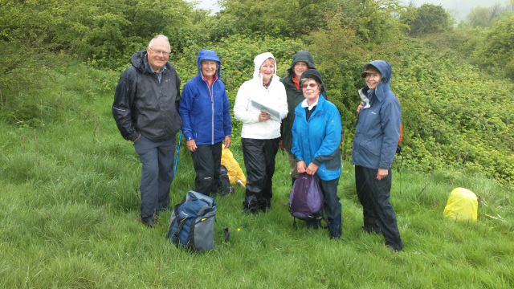
May –Sue and Liz’s first walk as leaders at Kelston.

Slide 17
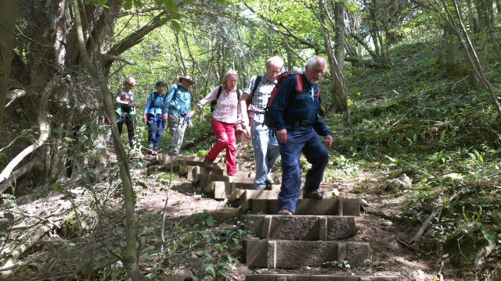
May-Gordon and Wendy’s Walk at Mells and Nunney

Slide 18
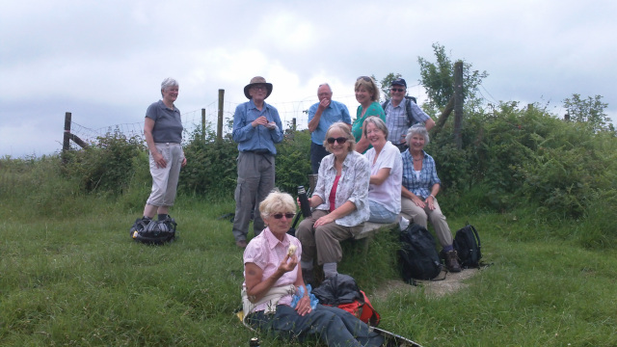
June - Summer Outing to Ludlow

Slide 19
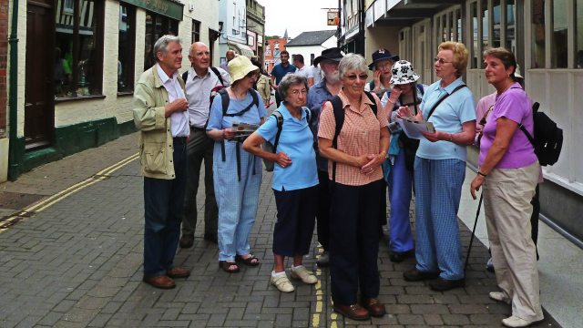
June –Summer Outing to Ludlow

Slide 20
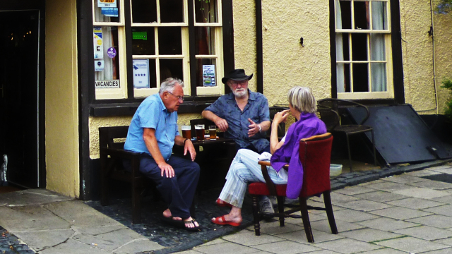
June –Summer Outing to Ludlow

Slide 21
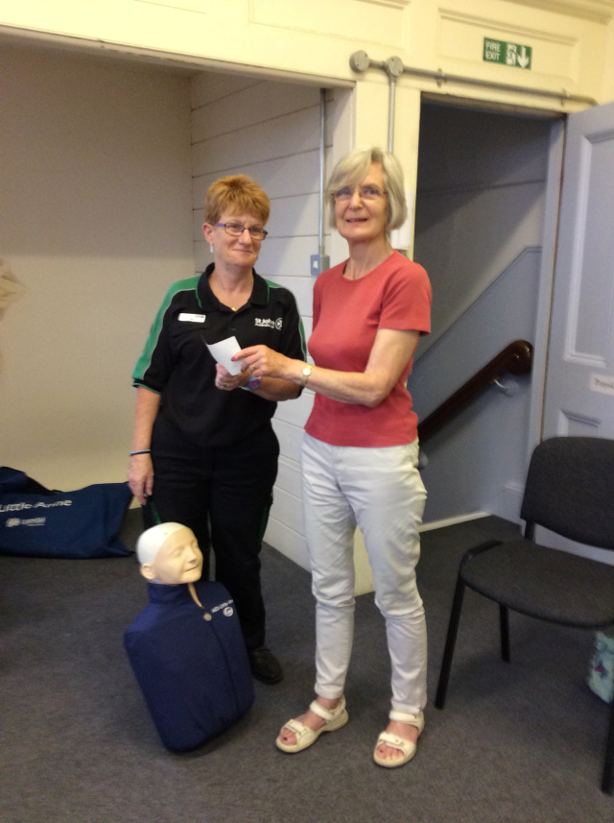
JULY –FIRST AID SAFETY TRAINING
Janet presents Pam Harris of St John Ambulance with cheque from the club.

Slide 22
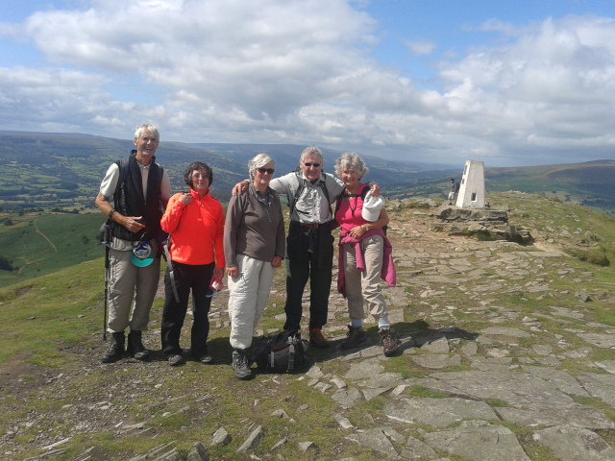
August –David Hayes’s walk up Sugar Loaf

Slide 23
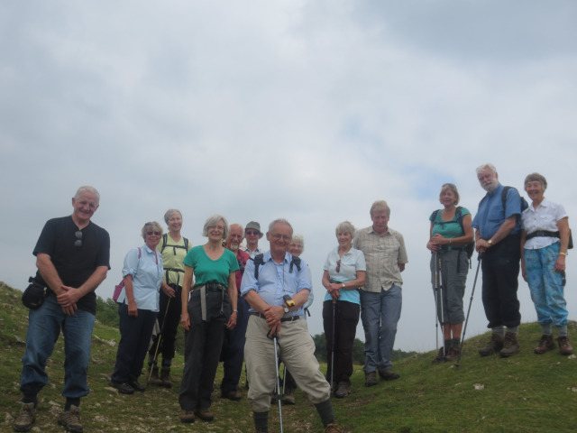
September – Sue and Liz’s walk at Dolebury Warren.

Slide 24
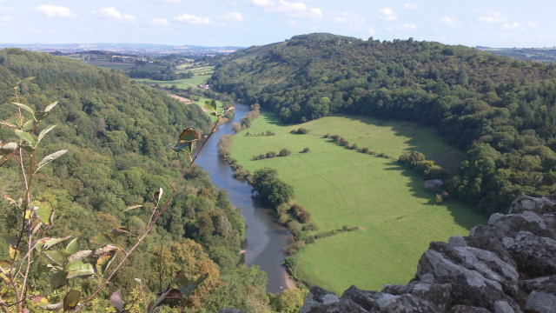
September –Helen’s walk at Symonds Yat

Slide 25
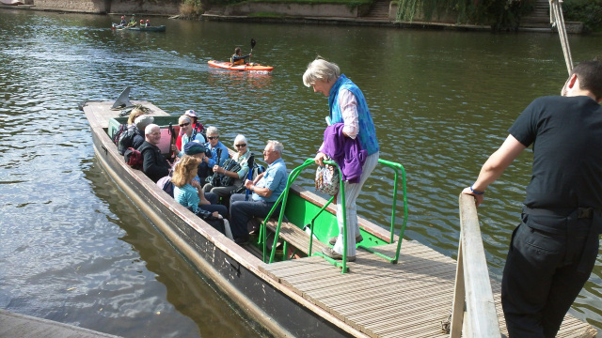
September-Helen’s walk

Slide 26
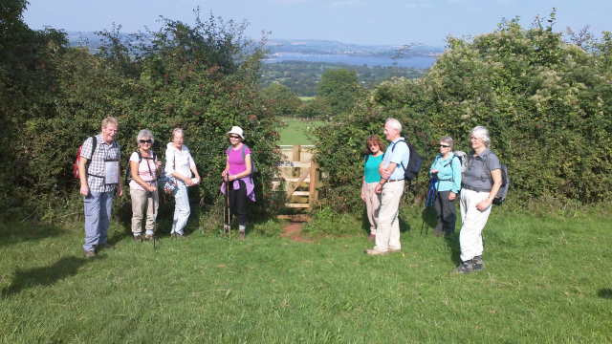
September –New Kissing Gate near Compton Martin (to be “adopted” )

Slide 27
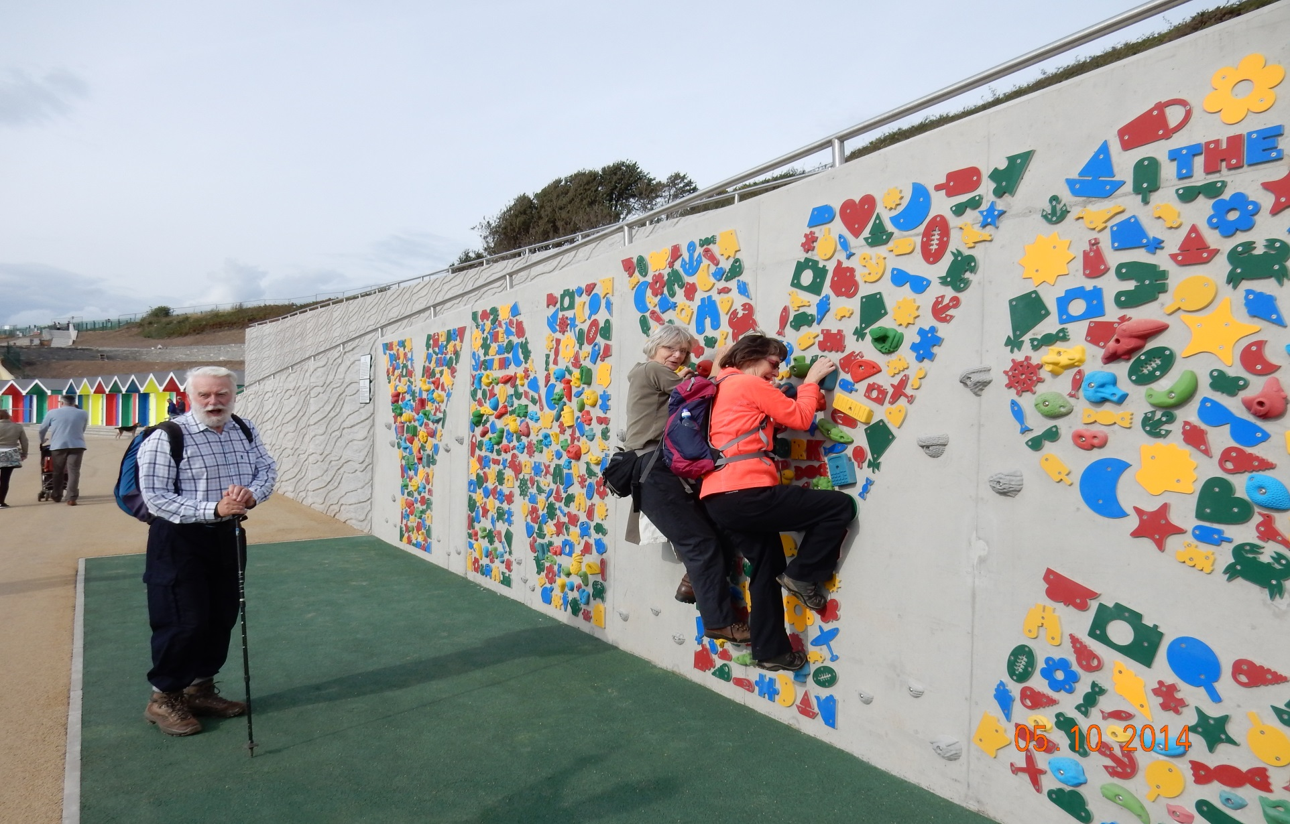
October –John Hollyman’s walk at Barry

Slide 28
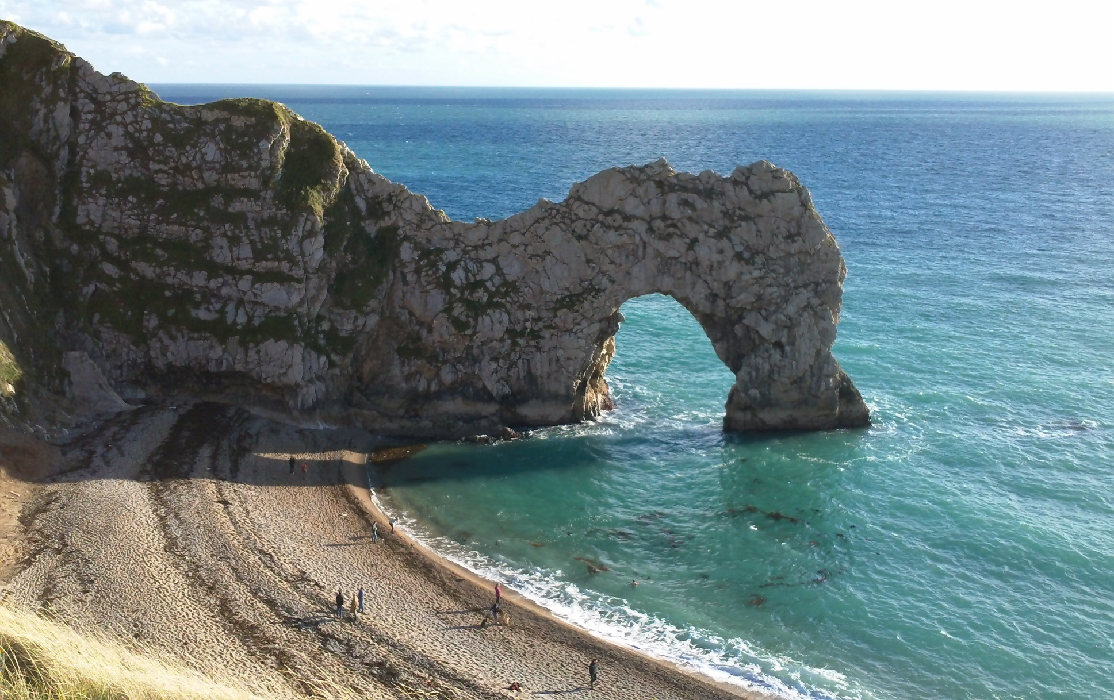
October –Week-end away at HF Lulworth Cove

Slide 29
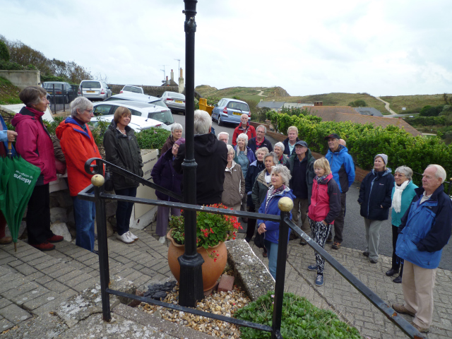
October –Week-end away at HF Lulworth Cove

Slide 30
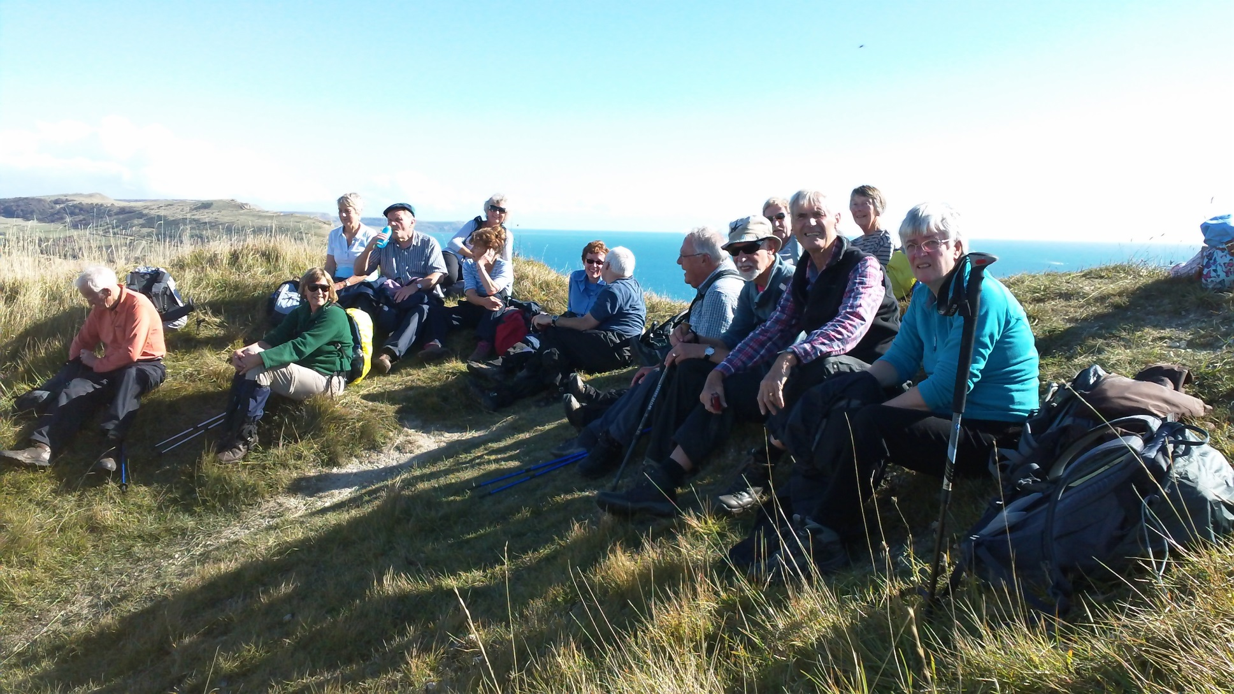
Lulworth Cove Week-end

Slide 31
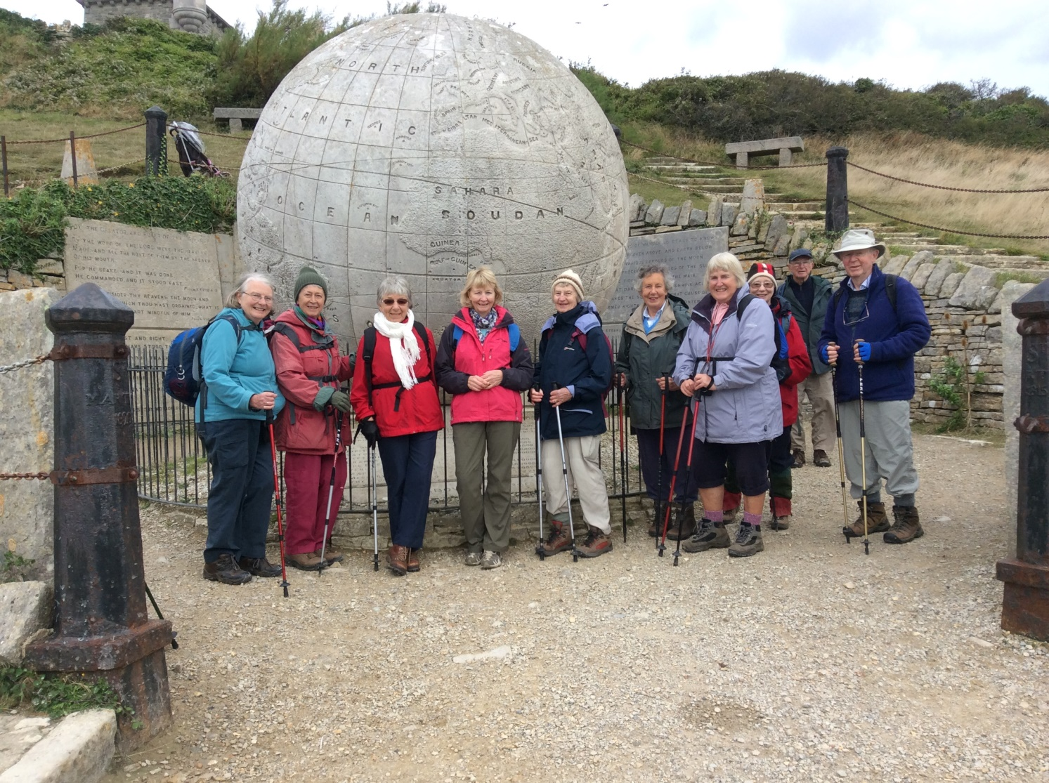
Lulworth Cove Week-end contd.

Slide 32
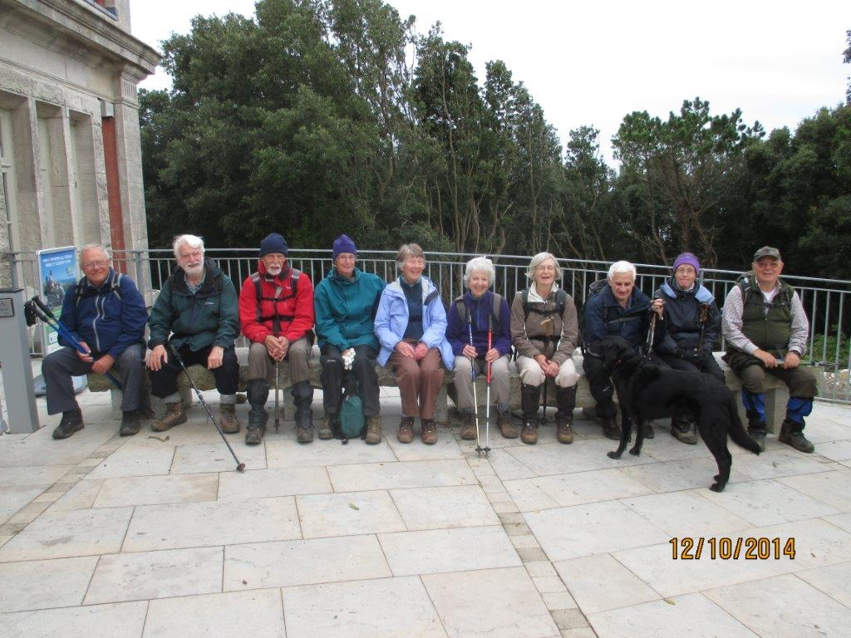
Lulworth Cove Week-end Contd.

Slide 33
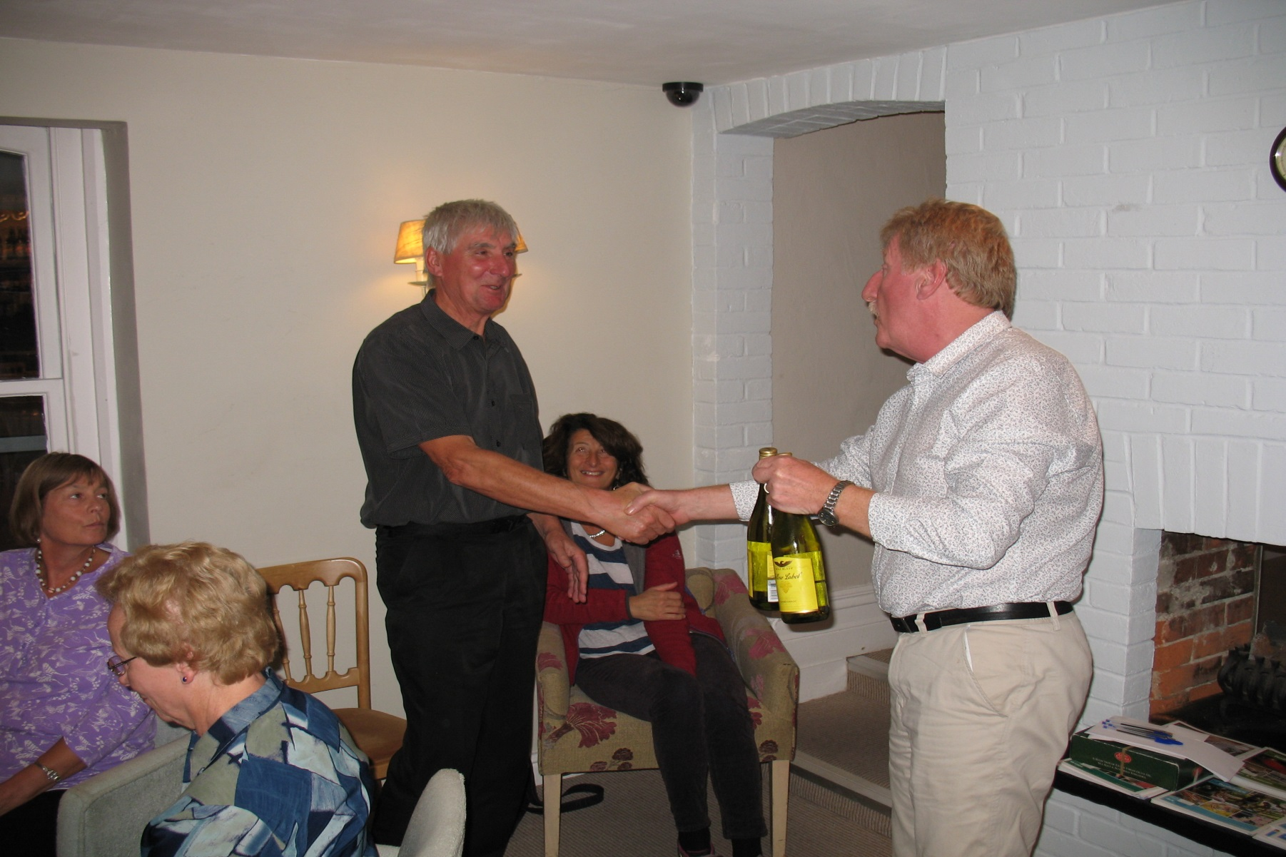
Presentations to Walks Leaders

Slide 34
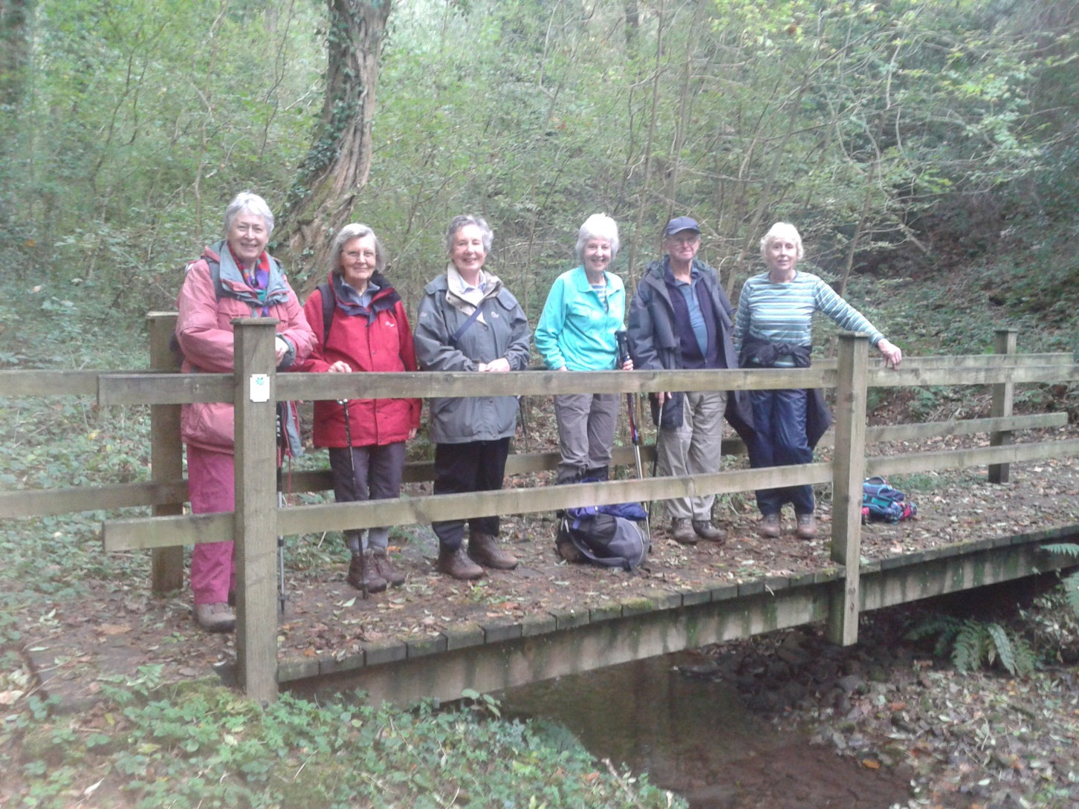
2 days ago-Pam’s walk around Abbot’s Leigh woods

Slide 35
Committee
Current
Neville Brewis (Chair),Sue Hazelden (Treasurer),Margaret Ruse (Secretary and Walks Co-ordinator),Rosanne Cawardine, Ian Hopley, Dick Dennett, Pam Porter, Helen Palmer and Chris Budd
Future
As above except that Ian and Dick are standing down after many years valiant service!
Liz Hall and Lorna Renshaw has agreed to replace them.
They are very WELCOME !

Slide 36
Membership Update
Currently have ~125 members
New Members since last AGM (October 2013):- Toby O’Hara, Roger Harvey, Robert Murphy, Caroline Maskew, Tony Johnson, Helen Gamsa, Wynel Rees, Rosemary Gwyn, Alison Shaw and Pat Goldsworthy(?)-WELCOME ALL!
Welcome back to Tony Pugh.
Renewal forms now out for 2014-15 with payment by on line bank transfer available.

Slide 37
Future Activities
Xmas Meal and Walks 2014
This year will be held at the FROMEBRIDGE MILL at Whitminster ( just off M5 Junc 13).on Thursday 11th December-see flyer from Dick Dennett in recent mail-out for details .
Cost - £15 for 3 course Xmas meal/first drink/raffle entry/staff gratuity – A GREAT DEAL
New Year’s Day Walk/Meal.
NOT ARRANGED YET -NEEDS ORGANISER(S) TO ARRANGE A COUPLE OF SHORTISH WALKS AND THE PUB LUNCH.
So please can someone volunteer to do this for the club.

Slide 38
Future Activities Contd.
Spring Social –March 2015
This will be held at (new venue) KINGS WESTERN HOUSE on FRIDAY 27th MARCH 2015.
Tour of and Talk about the house and its history will be presented followed by the normal American supper/refreshments.
Thanks to Sue Hazelden for organising this event.
Summer Outing June 2015
This is tentatively scheduled for SUNDAY 14th JUNE 2015.
Venue and arrangements still to be finalised.
Ideas and volunteers to help organise/lead walks are requested.

Slide 39
Future Activities Contd.
Annual Holiday weekend –October 2015
I have booked an HF Guided Walks package at Haytor on Dartmoor for the week-end of Friday 9th –Monday 12th October 2015. Plenty of room for 40-50 members to attend . Cost for week-end ~£275-£285/ person. Fuller details and booking form will go out with Winter Newsletter in December.
Future Newsletters + Editorship.
Committee has decided only to issue 2 paper Newsletters each year –Summer and Winter to coincide with issue of Walk Programmes. The Spring and Autumn ones will now be issued electronically via the Website on the NEWSLETTERS PAGE by the committee.
Davina has decided to step down as our Newsletter Editor and many thanks go to her for the great job she’s done over the last 2 years.
Felicity Brewis has agreed to take on the Editorship starting with the Winter edition in December.
On line payments to Club’s Bank account.
Reminder that in future all events/activities can now be paid for by direct BANK TRANSFER to Club Account as well as by normal cheque option.

Slide 40
THE END !
THANKS FOR YOUR PATIENCE !
ANY QUESTIONS ?

